Slide 1
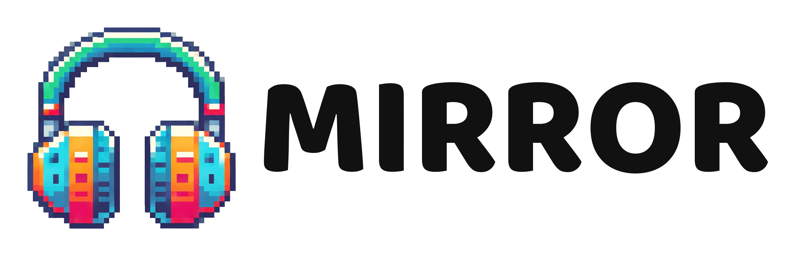
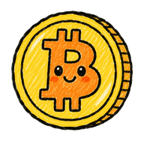

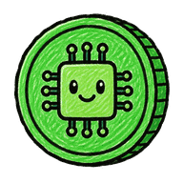
Stock Meme Offering (SMO) Launchpad
The first stock meme coin launchpad
SMO: a brand-new way to issue assets
mirror.top
contact@mirror.top

Slide 2

Evolution
From IPO to SMO
IPO
ICO / IDO
Meme launchpads
SMO
Issue shares
Issue tokens
Anyone can launch a coin
Issue stock meme coins
→
→
→
High barrier, only a few can join
Low barrier, but mostly no asset backing
No price backing, easily goes to zero
Meme virality plus stock-asset backing
02 / 18 · mirror.top

Slide 3
Definition
What is SMO
Stock Meme Offering: publicly issuing mapped meme coins backed by real stock tokens
Stock
Meme
Offering
Each coin is anchored to one real stock token (e.g. meTSLA to TSLA)
Community-driven; price moves freely with sentiment
Public curve issuance, pool trading after graduation, fully on-chain
SMO = stock backing + meme premium
03 / 18 · mirror.top

Slide 4
Pain points
Why SMO
Meme coins have no backing; going to zero is common
SMO
fixes all 3
1
Anyone can launch; rug pulls and insider dumps abound
2
Stock tokens are on-chain, but lack community play
3
04 / 18 · mirror.top

Slide 5
Comparison
SMO vs other issuance models
Item | IPO | ICO / IDO | Meme launchpads | SMO
Entry barrier | High | Low | Low | Low
Asset backing | Yes | Mostly none | None | Yes (stock tokens)
Who issues | Regulated companies | Project teams | Anyone | Listed by platform. Mapped to a US stock
Transparency | Periodic filings | Varies | On-chain | Fully on-chain
05 / 18 · mirror.top

Slide 6
Landscape
Today's meme launchpads
Pump.fun (Solana)
PONS (Robinhood Chain)
Anyone can launch; buy and sell on the curve; graduates to PumpSwap. Fast and lively, but no assets behind the coins.
Launchpad with a public curve; graduates to Uniswap V4 with locked liquidity. Uses stock tokens as trading pairs, for pricing only, no backing.
≈0.1%
They solved “how to launch a coin”,
not “what the coin is worth”.
PONS: 1,027 coins launched in 6 hours, 1 graduated (data from 2026-09-27)
06 / 18 · mirror.top

Slide 7
Deep dive
Mirror vs PONS vs Pump.fun
Item | Pump.fun | PONS | Mirror (SMO)
Who can launch | Anyone | Anyone | Platform-listed, one US stock per round
Link to stocks | None | Stock tokens as trading pairs: pricing only, no backing | Stock tokens locked to back the coin
Price floor | None | None | Has a floor price
Sell during launch? | Buy and sell | Buy and sell; creator tax may apply (0–19%) | Buy-only, no curve dumping
Graduation threshold | Auto by market cap | 4.2 ETH | Set per listing (meMSTR: 780 MSTR)
Pools after graduation | 1 PumpSwap pool | 1 Uniswap V4 pool | 2 Uniswap V4 pools: swap pool + trading pool
Where fees go | Curve 1.25%: 0.95% platform, 0.30% creator | 70% to creators; 80% of platform revenue buys back and burns PONS | 1%: 15% buys stock to raise the floor, 50% to LPs, 20% platform token buybacks, 15% protocol revenue
Who fees benefit | Platform and creators | Creators and platform token | Holders (the floor rises)
Fair distribution | Easily front-run by bots | Anti-snipe tax in first 3 seconds | Allowlist, max 0.1% per wallet
Chain | Solana | Robinhood Chain | Robinhood Chain
Note: liquidity locking is excluded from this comparison. Sources: pump.fun/docs, docs.bitquery.io, datawallet.com, cryptonomist.ch, api.loopholetape.com/rhc
07 / 18 · mirror.top

Slide 8
Advantages
Five things only Mirror has
1
Stock-backed
2
A rising floor
3
Fees flow to holders
Not priced in stocks, backed by stocks: real stock tokens locked behind every coin
Fees buy stock tokens for the pool and burn meme coins
Not just feeding the platform and creators; fees raise every coin's floor
4
Dual pools
5
Curve launch + graduated trading
Swap pool for backing and arbitrage; trading pool for everyday trades
Platform-listed, one US stock per round, fair curve launch.
Vault sets the floor, sentiment the ceiling.
08 / 18 · mirror.top

Slide 9
About us
Who is Mirror
The first SMO platform, running on Robinhood Chain (chain id 4663)
Platform-launched
Non-custodial
The platform launches every SMO round; users only subscribe and trade. One US stock per round, mapped to a meme coin.
Assets stay in users' own wallets; the platform holds nothing. A stock vault backs each meme coin.
09 / 18 · mirror.top

Slide 10
Lifecycle
The full lifecycle of an SMO
01
02
03
04
→
→
→
Pick a US stock each round
Public subscription (launch curve)
Graduation
Dual-pool trading
10 / 18 · mirror.top

Slide 11
Phase 1
Issuance: the launch curve
One USDG transaction
Earlier is cheaper
Pay in USDG; the contract swaps it to stock tokens and locks them in the vault
Curve pricing: the earlier you buy, the lower the price
Buy-only
10% reserved
No selling or refunds during issuance
10% of every subscription seeds the trading pool
11 / 18 · mirror.top

Slide 12
Genesis
Genesis SMOs
Issued by round + US stock
One US stock per round, and any US stock can be mapped and launched.
Launch phase: 0.1% cap per wallet
The genesis launch phase is allowlist-only: max 0.1% of total supply per wallet
meMSTR
First SMO · anchored to MicroStrategy (MSTR)
6 genesis listings
Genesis launches are allowlist-only: meMSTR, meTSLA, meNVDA, meCOIN, meMETA, meGOOGL
12 / 18 · mirror.top

Slide 13
Phase 2
Graduation: dual pools
Hitting the graduation line (meMSTR: 780 MSTR) auto-creates two pools on Uniswap V4
Swap pool · Pool A
Trading pool · Pool B
Stock token ↔ meme coin
USDG ↔ meme coin
Asset-backed
Secondary market trading
Protocol-supplied liquidity is locked; the lock contract is verifiable on-chain
13 / 18 · mirror.top

Slide 14
Core
The heart of SMO: the floor price
Floor price = swap pool stock reserve value ÷ meme coin circulating supply
Market price = floor price + meme premium
Below the floor, arbitrageurs push the price back up
Note: the floor is an asset-backed lower bound, not a buyback promise
14 / 18 · mirror.top

Slide 15
Flywheel
More trading, a thicker floor
Numerator up ↑
Vault USDG buys stock tokens for the swap pool
Denominator down ↓
Meme coins collected are burned by the multisig
Trading pool fee 1%
Dividends in
Real stock dividends are converted to the same stock token and added
Pump and PONS fees mostly go to the platform / creators;
Mirror fees flow back to the meme coin's floor vault, rewards to liquidity providers, and platform token buybacks.
Note: the protocol's 35% includes 20% for platform token buybacks
15 / 18 · mirror.top

Slide 16
Meme culture
Meme culture features
Titles
Leaderboards
Sniper, Genesis OG, Diamond Hands, OG numbers
Hall of Fame, Shrimp Board, live buy feed
Live moments
Long-term play
Whale alerts, graduation fireworks
Season points, Megaphone, floor-price mini game
16 / 18 · mirror.top

Slide 17
Roadmap
Ecosystem & roadmap
Done
Next
Later
Mainnet deployment
First SMO (meMSTR) listed
Allowlist system
First genesis launch
First graduation
Markets open
7 genesis SMO rounds
KOL partner program
Platform token $MIRROR (date TBD)
Pump is meme 1.0. SMO is asset-backed meme 2.0
17 / 18 · mirror.top

Slide 18
Mirror: Stock Meme Offering Launchpad
Rock bottom? We built one.
Sky's the limit? We didn't.
Every meme, backed by a stock
mirror.top
contact@mirror.top
Risk notice: meme coin prices are highly volatile, do not represent stock ownership or shareholder rights, and are not investment advice.

